Slide 1
Boots Brand Analysis
Data-Driven Insights and Strategic Recommendations for Stakeholders

Slide 2
Agenda
Project recap
Business questions
Development process
Software used
Project flow
Insights

Slide 3
Project Recap
This project was initiated by Boots to gain a deeper understanding of the key characteristics and differences between two of its brands. The objective was to analyze the provided data and deliver actionable insights that would inform strategic decisions and optimize brand performance.
Boots tasked our team with a focused analysis to enhance brand strategies. Over a brief engagement, we delivered:
A comprehensive audit of brand performance.
Data-driven recommendations for strategic improvement.
Insights into key brand characteristics and market positioning.

Slide 4
Business Question
Business Question 1
Business Question 2
What are the key differences?
What are the key characteristics of each brand?
Business Question 4
What customer campaigns could you run for Brand B?
Business Question 3
What would your recommendation to the company on which brand to focus on?

Slide 5
Development Process
Data Extraction:
The project began by extracting relevant data into Excel. This data included various tables related to brand performance
and sales metrics.
Data Transformation:
The extracted data was organized into multiple sheets within Excel, each representing different tables. Special attention was given to transforming the general and sales tables to ensure they were structured appropriately for analysis.
Data Loading:
Once the data was cleaned and structured, it was loaded into Power BI for further analysis and visualization. This allowed for the creation of dynamic dashboards and reports that could provide actionable insights to stakeholders.

Slide 6



Software Used
Excel
Power Bi
Powerpoint
Excel was chosen for its robust data manipulation capabilities. It allowed for efficient extraction, cleaning, and transformation of data into a structured format
Power BI was utilized to leverage its powerful data visualization and analytical features. it enabled the creation of interactive dashboards and reports
PowerPoint was used to compile and present the findings in a clear and visually appealing format

Slide 7
Process Flow
Data
Extraction
Data Transformation
Data
Loading
Insights

Slide 8
BUSINESS
QUESTIONS !

Slide 9
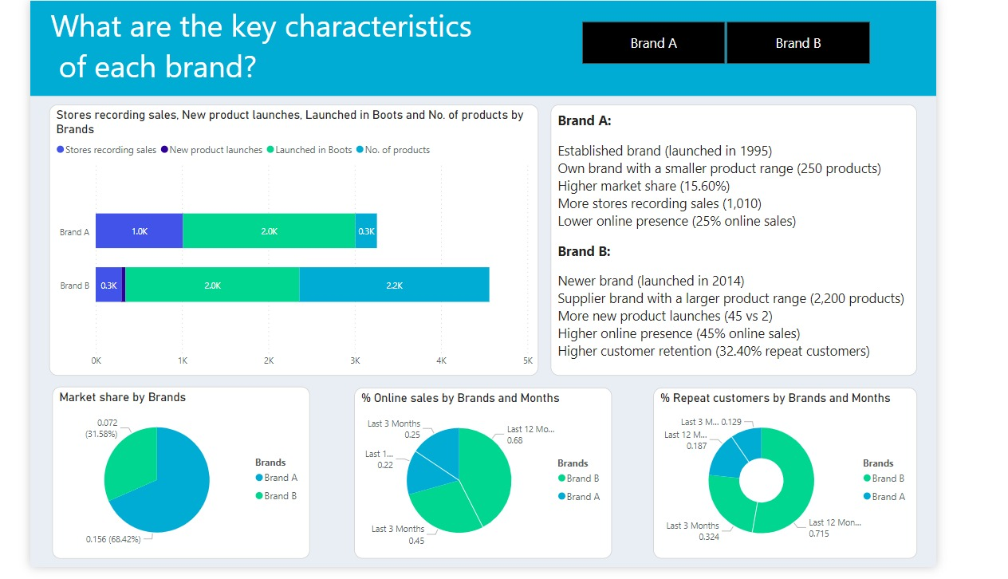
Business Questions: 1

Slide 10
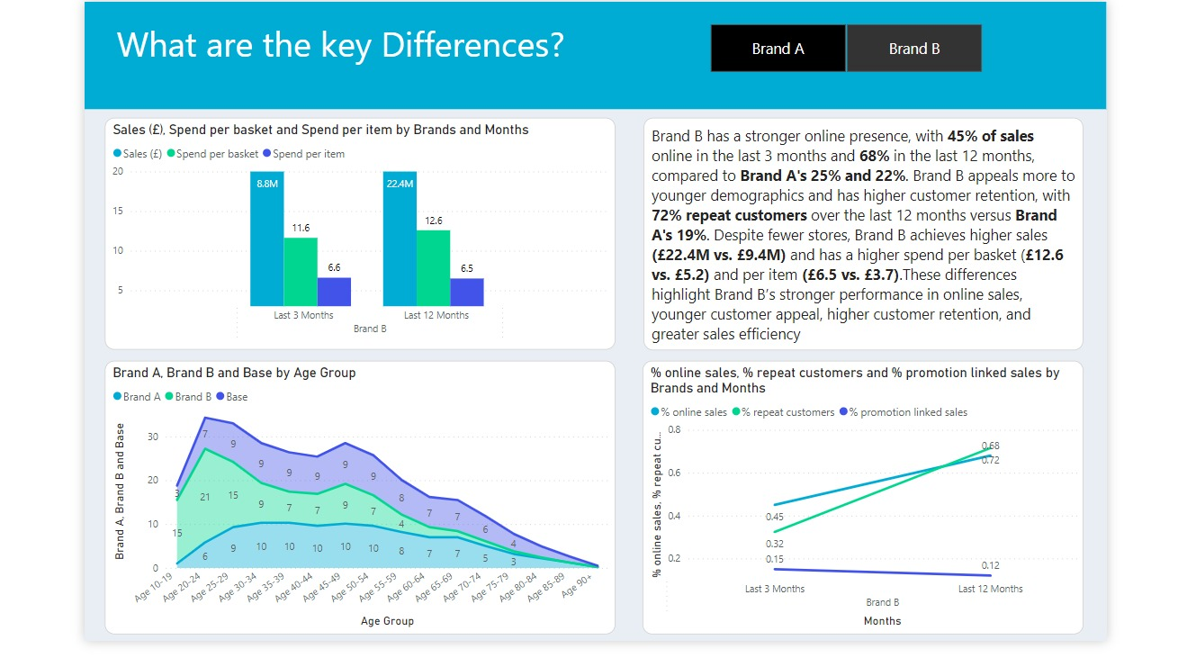
Business Question : 2

Slide 11
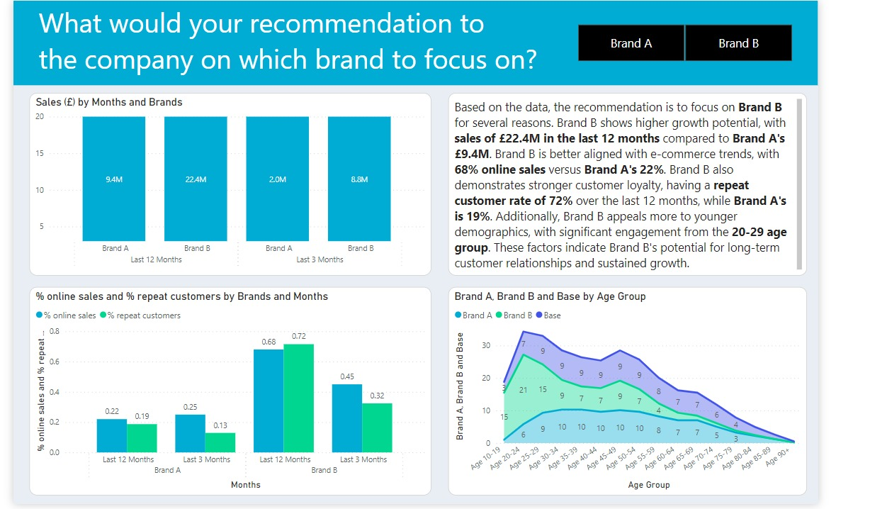
Business Question : 3

Slide 12
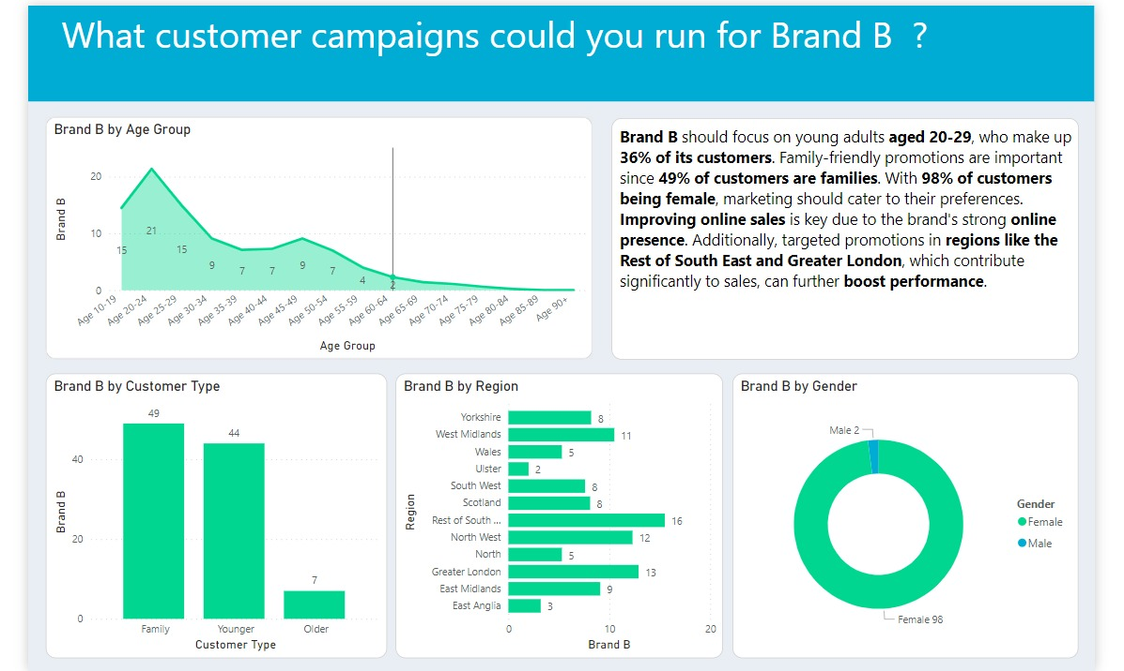
Business Question : 4

Slide 13
Conclusion
Brand B has significant growth potential, particularly in the online sales segment, with a high repeat customer rate.
Younger demographics, especially those aged 20-29, are more engaged with Brand B, making it a key target for future marketing.
Brand B outperforms Brand A in e-commerce, with 68% of its sales being online, indicating strong digital presence and customer loyalty.
Brand B performs strongly in key regions like the South East and Greater London, contributing significantly to its overall success.
Brand B has introduced more new products compared to Brand A, appealing to trend-conscious consumers and driving innovation

Slide 14
Future Recommendations !
Prioritize Brand B in marketing and promotional efforts, focusing on its strengths in online sales and younger demographics.
Invest in and optimize Brand B’s online sales strategies, enhancing user experience and personalized marketing campaigns.
Strengthen Brand B's market share in high-performing regions, while exploring tailored strategies for underperforming areas.
Continue focusing on product innovation for Brand B, ensuring new launches align with consumer trends and preferences.
Regularly monitor Brand B's performance and adjust strategies as needed to respond to market shifts and consumer behaviour trends

Slide 15
Thank
You!
Yeah ! Insights are Cool!!
Any Question?
D you like it ?

